Slide 1

Cash Compactor
Rapscallionion

Slide 2

ABOUT US – Get to know us better
Who we are:
Cash Compactor is a start-up company aiming to maintain and improve our environment through a smart recycling system.
As a company, we want to promote and enforce responsible recycling on a global level.
What we believe in: Facilitate consumers' lives and provide incentives to keep our world green.
Our customers' information should remain private.

Slide 3
Pain points – problems we will solve
01
Landfill waste
02
Inconvenience
Of the 26 million tonnes of waste produced in the UK, 12 million tonnes are recycled, and 14m tonnes are sent to landfill sites. This adds up to an average recycling rate of 45%.
By facilitating the recycling process and rewarding customers with vouchers, we will overcome the inconvenience of current recycling methods and ensure we are maintaining loyalty through incentives.
03
Ignorance towards sustainability
04
Government owned recycling centres
By monetising this product, people will be encouraged to help clean up the environment.
Government-owned recycling centers in the UK can lead to inefficiency and lack of innovation.
Privatization would drive down costs and improve recycling rates through better technology and service.
05
Security and Privacy
Ensure that local information, recycling habits, and data are private.
We only track what materials are used and how often they are. ​
Notes:
Privatise recycling

Slide 4


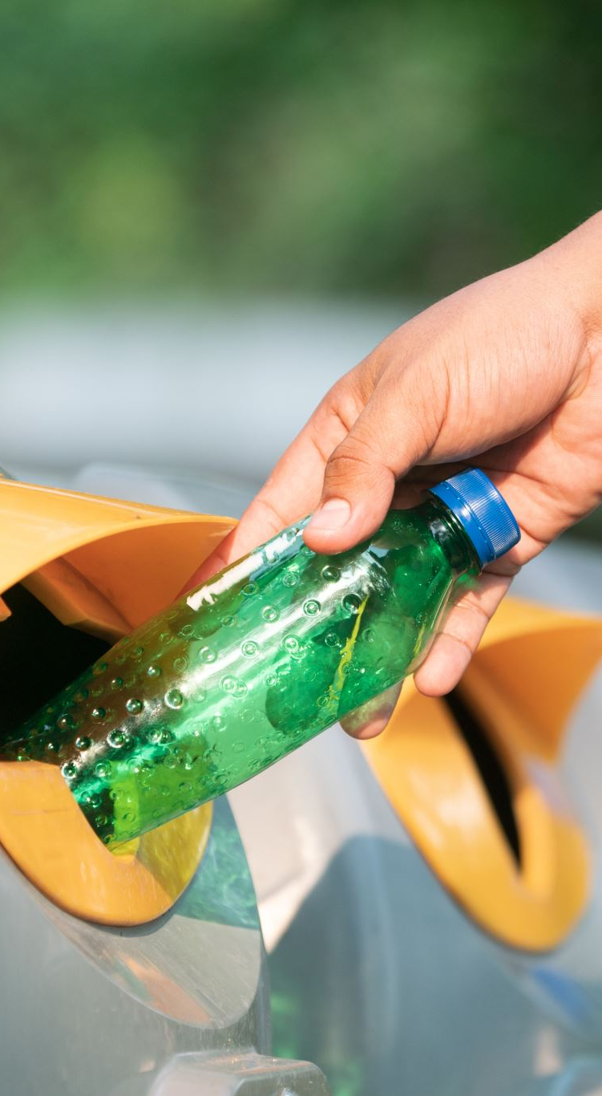
Introducing cash compactor
Introducing recycling machines incentivises users to use points to dispose of their rubbish.
Integration of a mobile app for users to scan at the machine and deposit their waste.
Utilising of Tezos to create smart contracts on the blockchain for managing user wallets and points.
Sustainability aspect:
Promotes recycling and waste reduction by providing tangible rewards.
Physical cards will only be given to those who request them actively. A delivery fee will be issued as to encourage the use of the digital, environment-friendly method.
Encourages behavioural change towards responsible waste management. Contributes to environmental conservation by diverting waste from landfills. Enhances community engagement in sustainable practices.

Slide 5
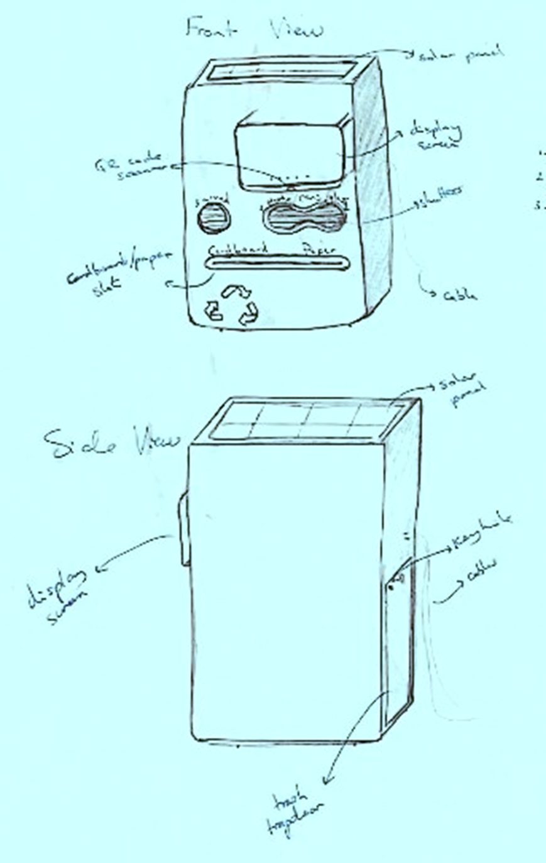
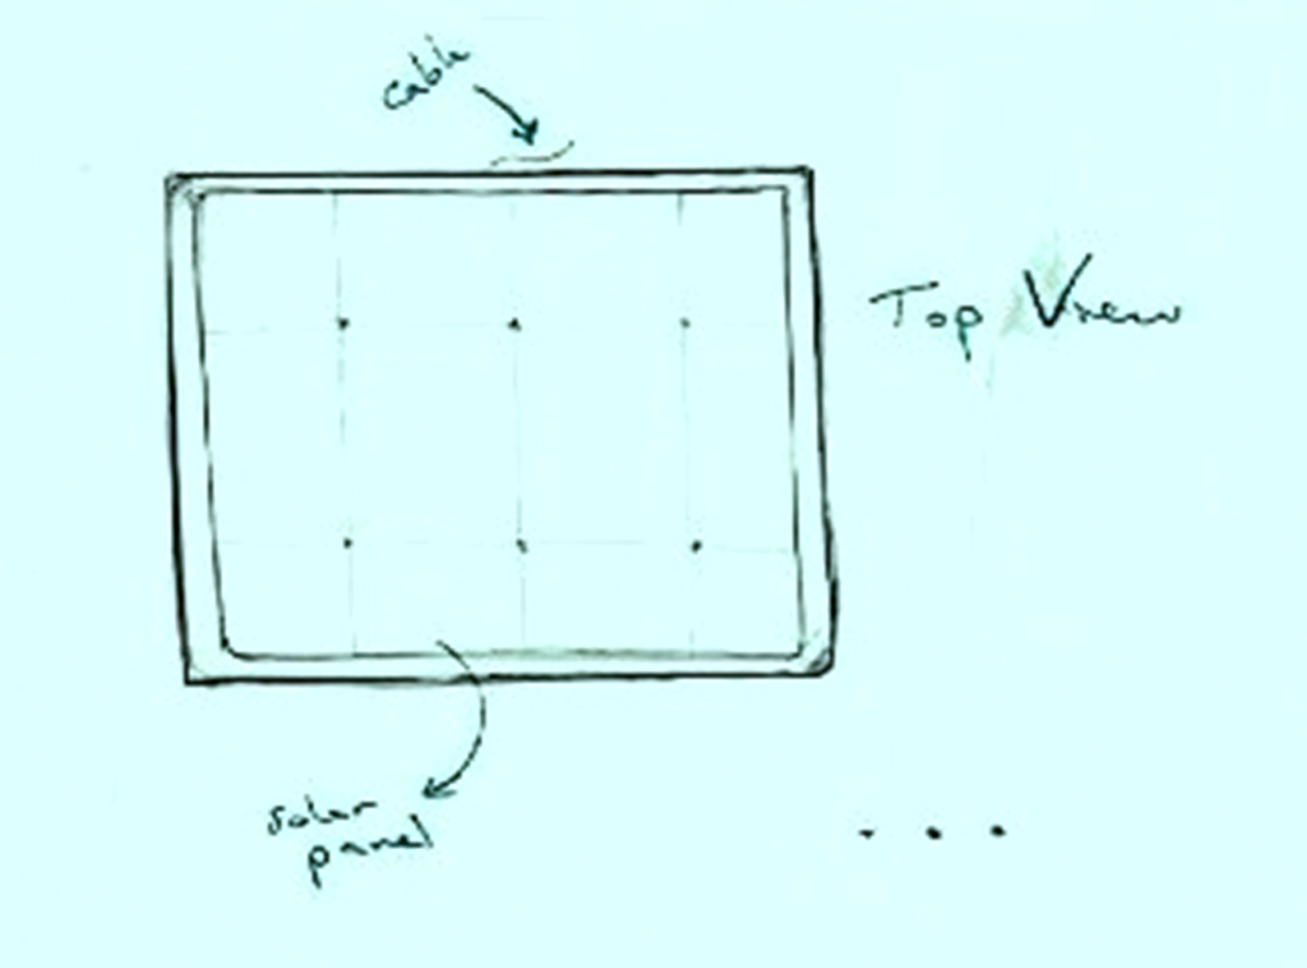
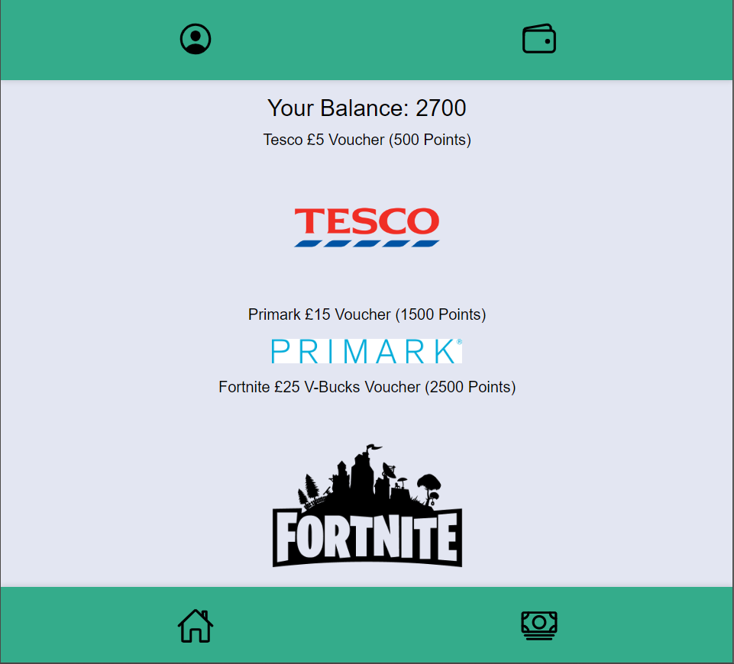
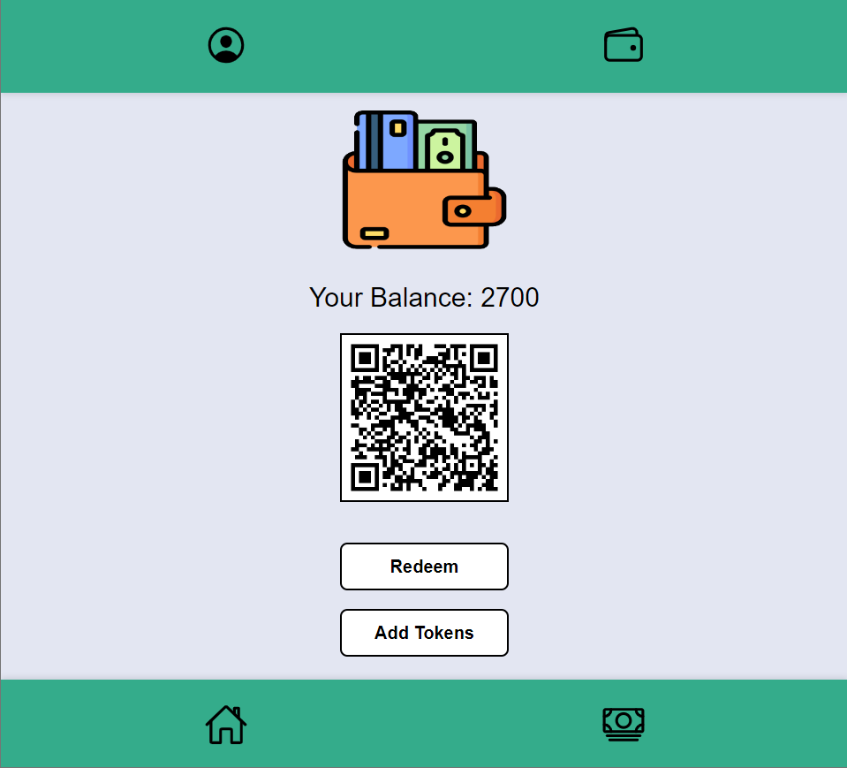
Product demo

Slide 6
profit Making
Government Funding
Advertising
White-label solutions
Government schemes and funds can help cover our expenses:
Waste and Resources Action Programme (WRAP)
Innovate UK Funding (UKRI)
Enhanced Capital Allowance (ECA) – 100% off the cost of energy-efficient equipment in the first year the equipment was purchased
We aim to use in-app advertising within our mobile app that shows customers adverts relevant to the supermarkets we partner with, as well as adverts that are linked with recycling. Also, we aim to have on-device advertising on our product.
Cost per thousand impressions (CPM) vs. location-based pricing
Static ads vs. video ads
We aim to rent our machines to the supermarkets we want to partner with and to other supermarkets we wish to partner with in the future to make a profit and provide our customers with more variety in the stores where they can spend their coupons.
Notes:
Supermarkets, including Iceland and Tesco, offer a 10p coupon for every recyclable bottle that is returned to the store.
Sainsbury’s will give a 5p coupon for every recyclable bottle returned to the store and inserted into their reverse vending machine.
We plan to work with supermarkets with a recycling reward system.
Promoting not only our product but also the companies we are partnered with to encourage our consumers and theirs to recycle.
These coupons can be redeemed for cash or used to offer discounts at the supermarkets we partner with.

Slide 7
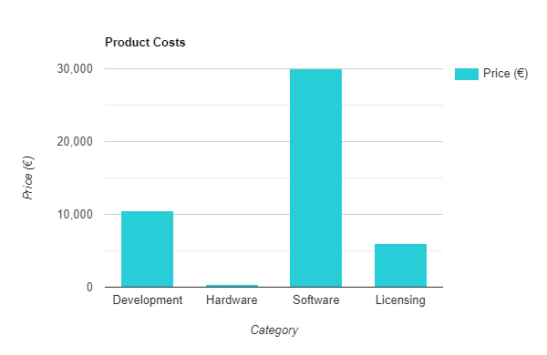
Cost of our product
Grand Total:
Production costs start from:
£46,830.
Notes:
Machines
This consists of:
Prototype development
(€10,000 - €50,000)
Mass production costs
(€500 - €1,500)
Total cost per unit:
€10,500-€51,500
Hardware
This consists of:
conveyor/motion system (€200 - €1,000)
weighing/counting mechanism (€50 - €200)
processor (€10 - €50)
Display/touchscreen (€20 - €100)
Mobile Payment System (€50 - €200)
Total cost per unit:
€500 - €2,500
Software
This consists of:
Back-end infrastructure
€10,000-€30,000
User interface design
€5,000-€15,000
Payment processing integration
€10,000-€50,000
Barcode scanning software
€5,000-€20,000
Total cost per unit:
€30,00 - €100,00
Licensing
This consists of:
Barcode scanning certification
(€1,000 - €5,000)
Recycling certification
(€5,000 - €20,000)
Total cost per unit:
€6,000 - €25,000

Slide 8
Success rates in other countries
As of 2024, 30 countries have plastic bottle deposit systems
Germany
Germany’s Pfand system allows customers to pay a deposit when they buy certain products, and they will get the deposit back when they return the product.
This program is the most successful in the world with reports claiming that the success rate has increased to 98% as of 2024.
However the system only works for products that have a specific barcode.
There main recycled product is bottles rather than a range of other recyclables.
Britain
Britain has a recycling programme that charges customers an additional deposit fee when they purchase a drink in a single-use container.
This deposit is an incentive to support recycling - it is redeemed when the consumer returns the empty container to a return point.
However this system only accept soft drinks.
United States of America
Recycling deposits have been introduced in 10 states.
America as a whole is only successful recycling 32% of their waste.
Canada
Canada’s recycling deposit scheme has been successful, with the program collecting 60-70 % of recyclable products through the programme.
However, only 9% of all waste is recycled.
Notes:
Germany: USA: 10 states include: California, Connecticut, Hawaii, Iowa, Maine, Massachusetts, Michigan, New York, Oregon and Vermont. The programme is not implemented nationwide, with only 20% of the states participating, which shows that America is not successful with its recycling programme.

Slide 9
TAKE ACTION FOR OUR PLANET BEFORE IT’S TOO LATE
Thank you for your time.

